Slide 1

Enzyme Classification
Final Year Project Presentation
Indian Institute of Information Technology, Nagpur
Dept. Of Computer Science and Engineering
Group Members - Sneha MAdiri - BT19CSE030
k. sriram - BT19CSE025
shashank kanojiya - BT19CSE068
Abhinav kumar dubey - BT19CSE116
NAME OF THE SUPERVISOR:
DR. RAHUL SEMWAL
(ASSISTANT PROFESSOR)
Session 2022-2023

Slide 2
Enzyme & it's importance
Enzymes are proteins that act as catalysts in biochemical reactions.
The dysfunction of certain enzymes would cause serious metabolic diseases.
Enzyme Classification number (EC): Oxidoreductase (EC1), Transferase (EC2), Hydrolase (EC3), Lyase (EC4), Isomerase (EC5), Ligase (EC6) and Translocases(EC7).

Slide 3

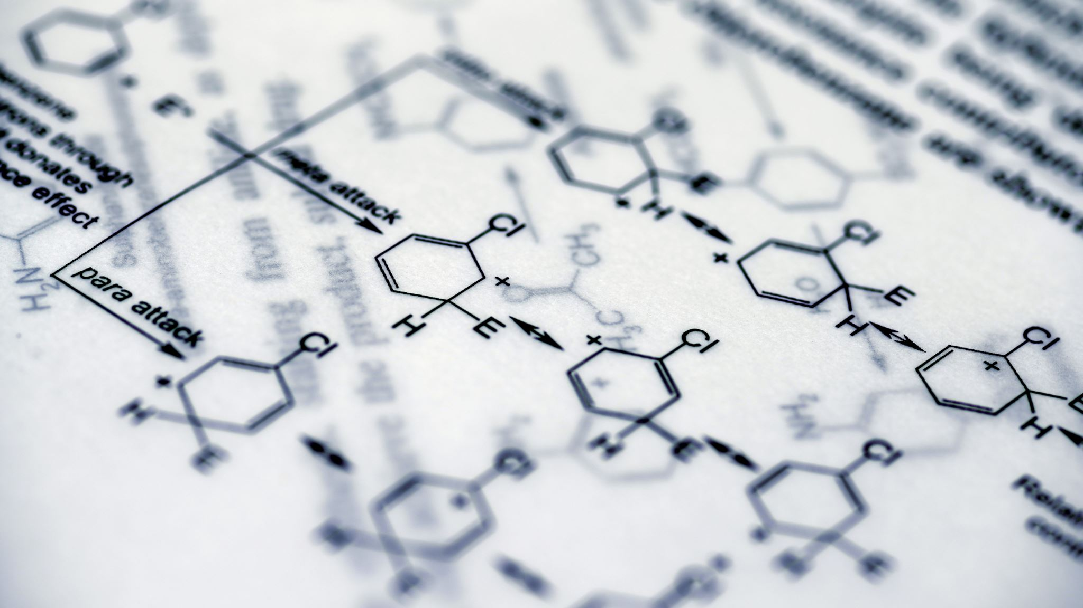
Enzyme classification objective
Develop accurate ML algorithm for enzyme classification into main classes.
Distinguish enzymes from non-enzymes for novel enzyme identification.
Use sequence features for classification.
Enable rapid enzyme classification for insights and applications.

Slide 4
LITARETURE REVIEW
Research Paper | Published Year | Preprocessing technique | Feature Extraction | ML/DL Model
The Classification of Enzymes by Deep Learning | May 22, 2020 | PISCES CD-HIT | PseAAC PsePSSM FunD CTD | SVM KNN OTHER DL MODELS
CLASSIFICATION OF ENZYMES USING MACHINE LEARNING BASED APPROACHES: A REVIEW | December, 2015 |  | PROFEAT | SVMRFE
ABLE: Attention Based Learning for Enzyme Classification | November 13,2020 | CD-HIT | one hot encoding text embedings | CNN LSTM
DeepEnz: prediction of enzyme classification by deep learning | May,2021 |  | 1.LabelBinarizer function 2.Tokenizer function | LSTM
Protein Data Analysis |  |  | TAPE and ESM-1b embeddings | BERT TRANSFORMER
DEEPre: sequence-based enzyme EC number | 23 October 2017 |  | 1.Sequence one-hot encoding 2.Position specific scoring matrix

Slide 5
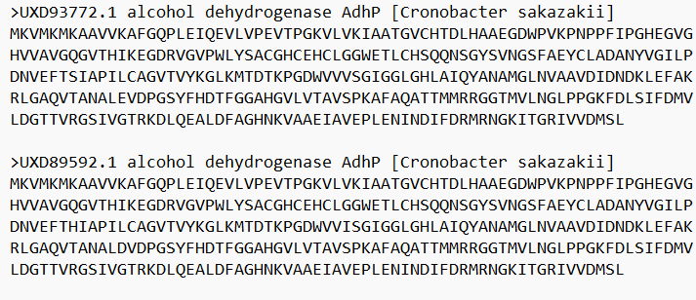
Data Collection and Analysis
Sequences are collected from various databases like GenBank, PDB & Uniprot.
For each class, first 6 sub-groups are taken in account while collecting data.
Sequences are collected from NCBI.
For Enzyme Dataset
For Non- Enzyme Dataset

Slide 6
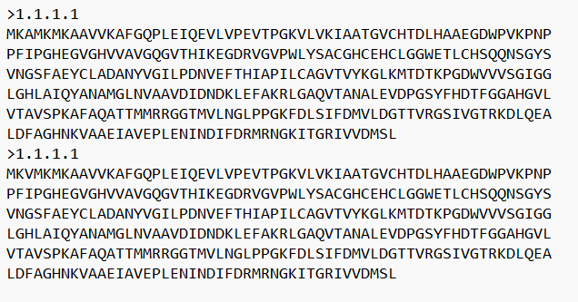
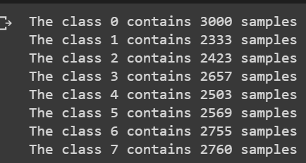
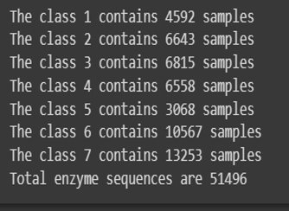
Data Preparation
Data Cleaning
Data Pre-processing
CD-HIT(c=0.7)

Slide 7
FEATURE EXTRACTION TECHNIQUES
Amino Acid Composition
Dipeptide Composition
Composition, Transition and Distribution
Primary Features

Slide 8

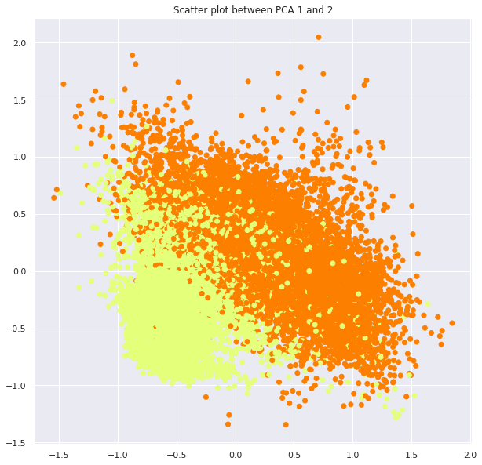



ENZYME VS NON-ENZYME CLASSIFICATION

Slide 9
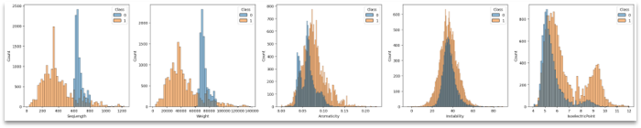
Primary Features:
Sequence Length: Total number of amino acids in the protein sequence, indicating protein size.
Weight: Molecular weight of the protein, reflecting its mass.
Aromaticity: Proportion of aromatic amino acids (e.g., phenylalanine, tyrosine, tryptophan) in the sequence, contributing to structure and function.
Instability: Index measuring protein instability based on specific amino acid sequences.
Isoelectric Point (pI): pH at which the protein has no net charge, influencing solubility and behavior in different pH conditions.

Slide 10
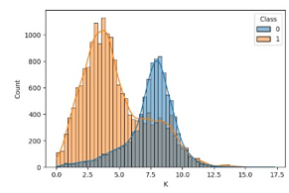
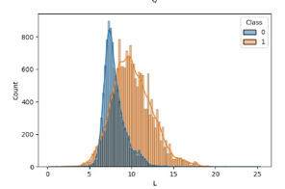
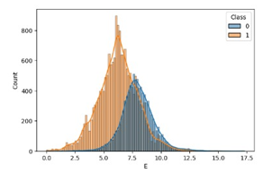
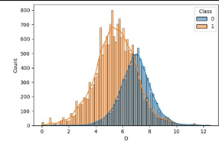
Amino Acid Composition

Slide 11
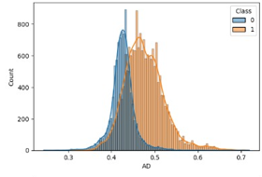
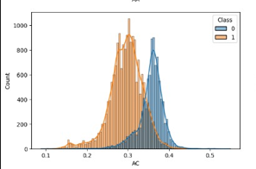
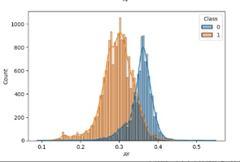
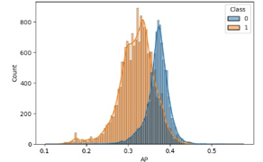
Dipeptide Composition

Slide 12
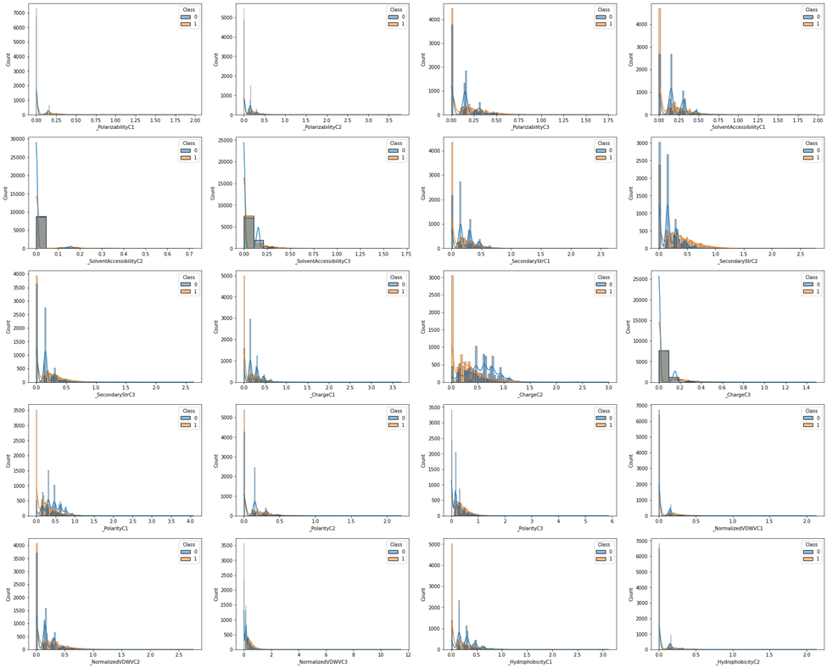
Composition, Transition and Distribution
Working of CTD:
The enzyme sequence (s) is divided into segments of equal length, typically three.
For each segment, the occurrence of each amino acid is counted.
The occurrence counts are normalized by the total number of amino acids in the segment, resulting in the composition distribution for that segment.
The composition distributions for all segments are concatenated, resulting in a feature vector representing the composition transition distribution for the entire protein sequence.

Slide 13
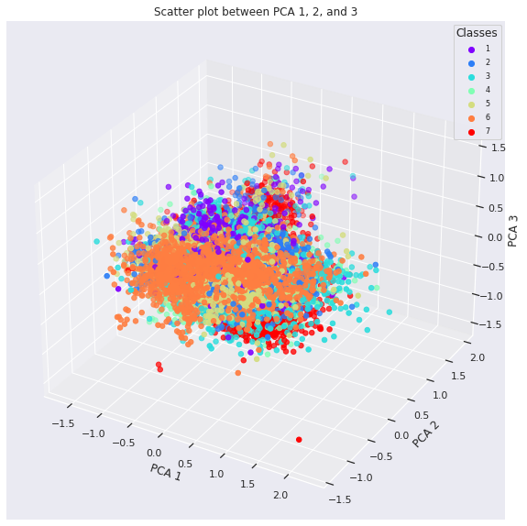
7 CLASSES CLASSIFICATION

Slide 14
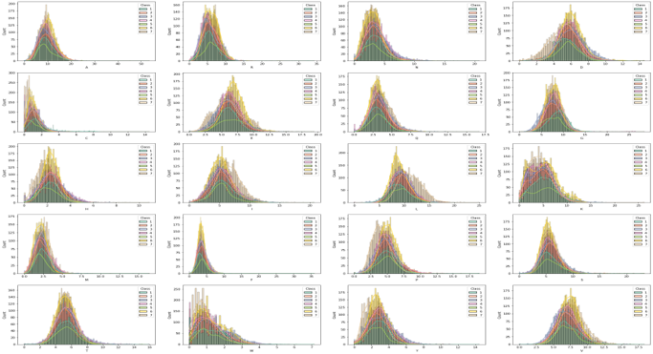
Amino Acid Composition

Slide 15
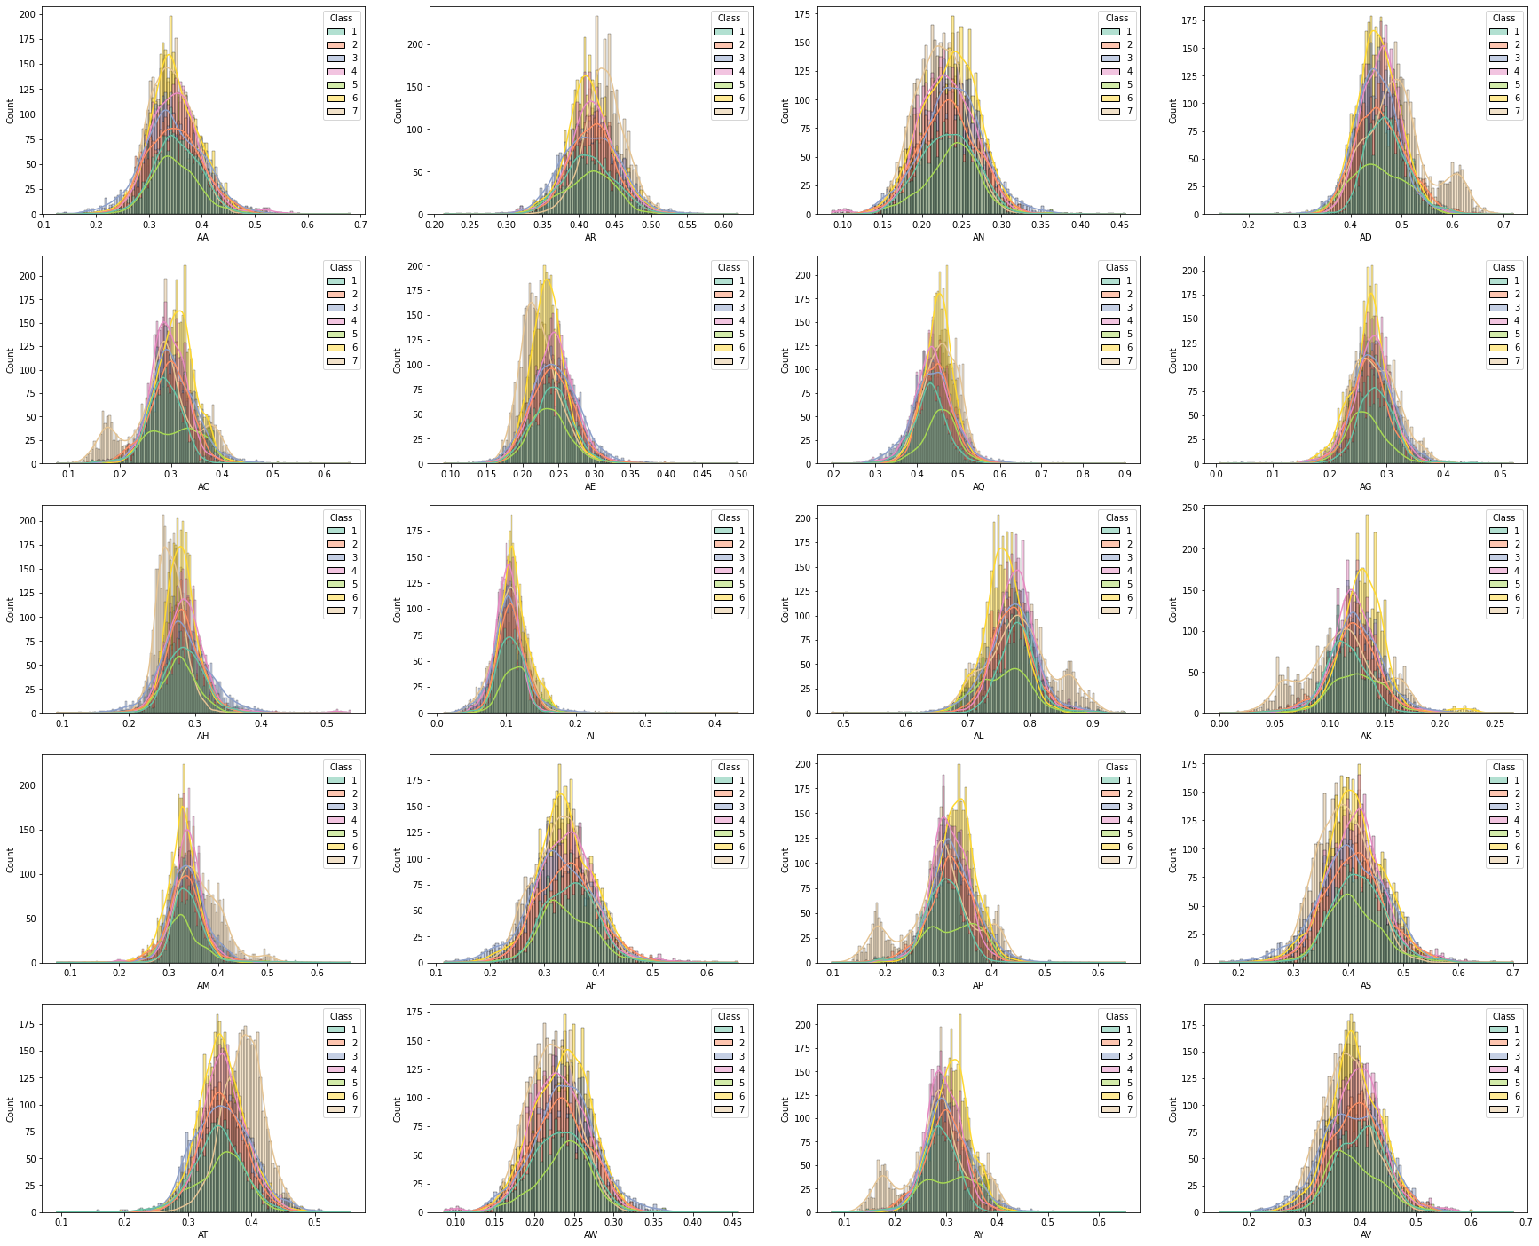
DIPEPTIDE COMPOSITION

Slide 16
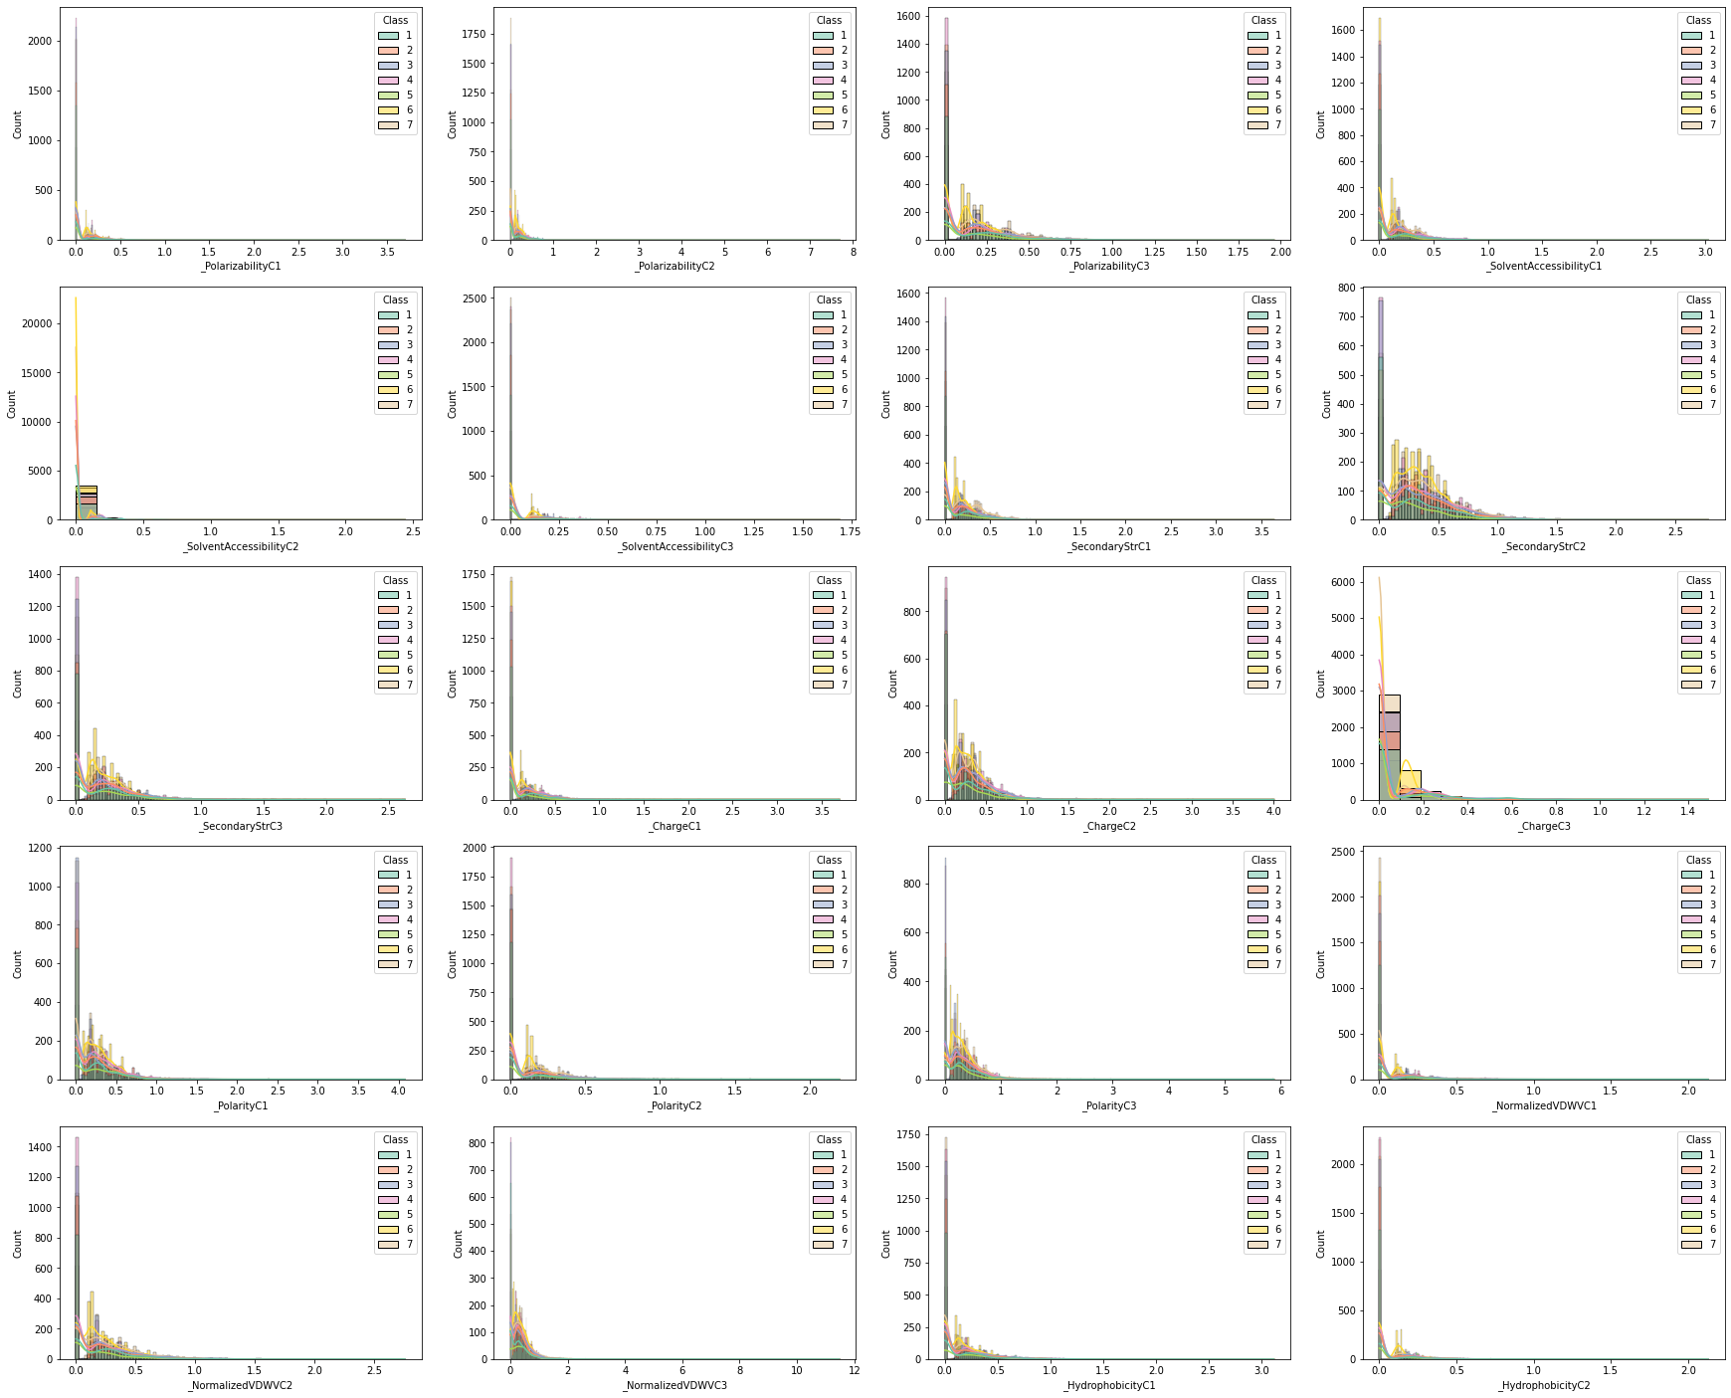
Composition, Transition
and Distribution

Slide 17
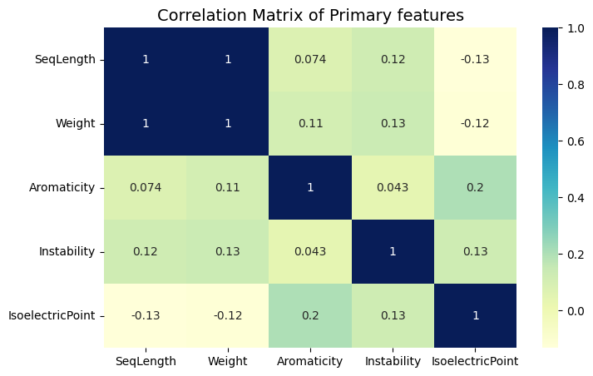
Feature Selection: Correlation
Positive correlations indicate that as one feature increases, the other feature tends to increase as well.
Negative correlations indicate that as one feature increases, the other feature tends to decrease.
Weak or no correlations suggest that the features are relatively independent of each other.

Slide 18
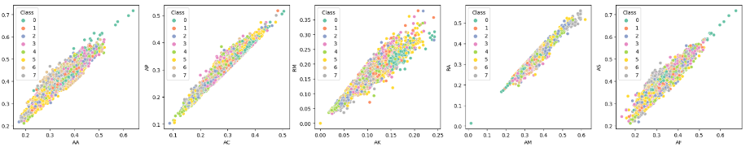
Correlation between Dipeptides
During the analysis, we found 25 pairs of dipeptide features that exhibited a correlation of more than 90 percent.
These feature pairs showed a strong positive or negative correlation, indicating a significant relationship between them.

Slide 19
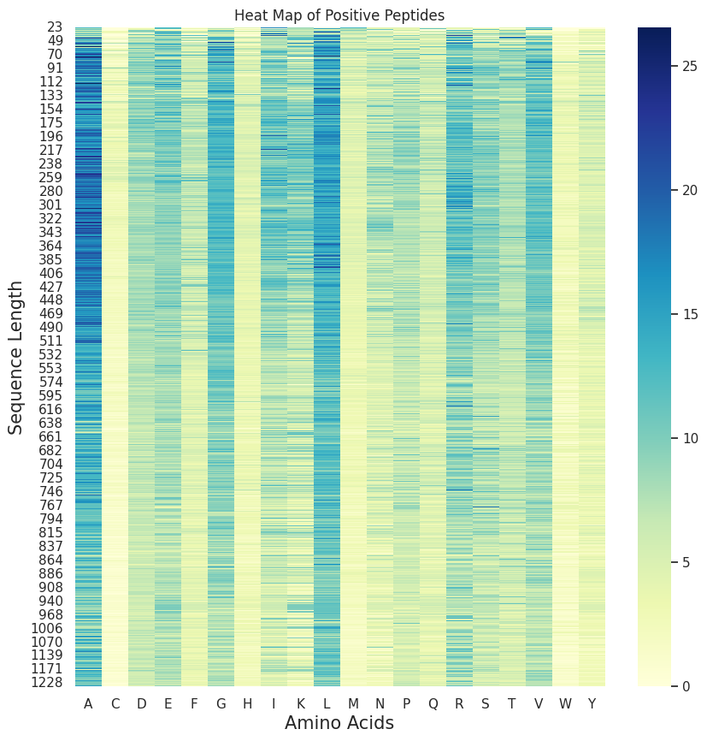
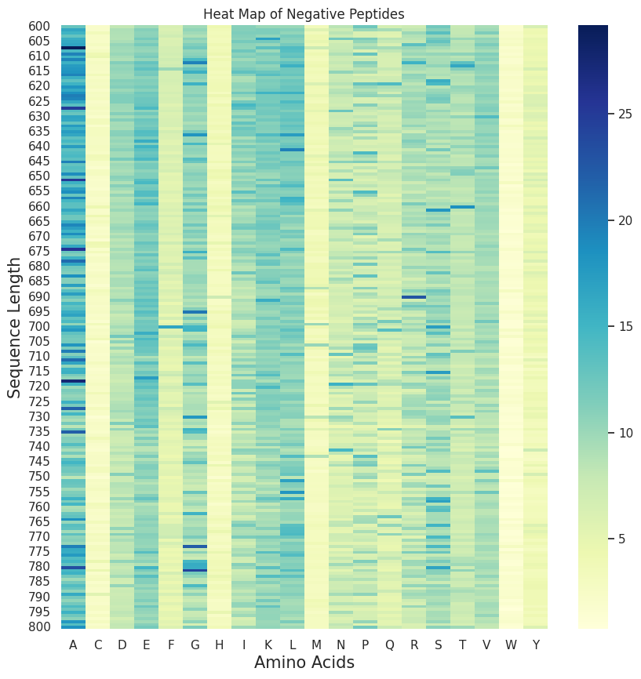
Heat maps of Enzyme and Non-Enzyme
Enzyme heat map: A, G, L, R, and V amino acids showed slightly higher frequencies, suggesting their potential importance in enzyme function.
Non-enzyme heat map: A, E, I, K, L, and G amino acids occurred more frequently, indicating their potential association with non-enzyme biological functions.

Slide 20
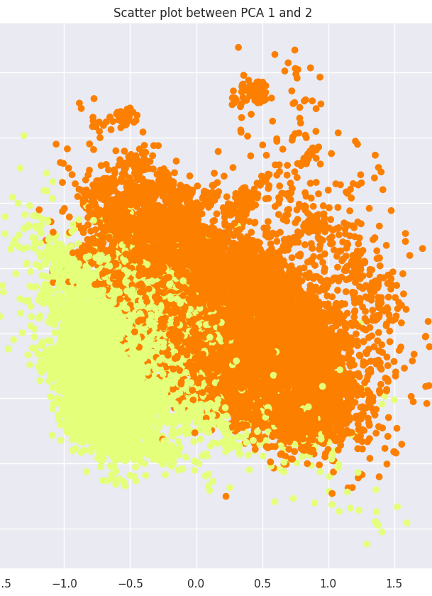
Principal Component Analysis
Applied PCA to dataset of enzymes and non-enzymes.
Plotted PCA1 against PCA2.
No clear linear separation observed.
Suggests non-linear models for better classification.
Explore non-linear models to capture patterns.

Slide 21
Data Splitting
Dataset split into train, test, and validation sets.
Input data shape: (26962, 546), Output data shape: (26962).
Training set: 17255 data points.
Validation set: 4314 data points.
Testing set: 5393 data points.

Slide 22
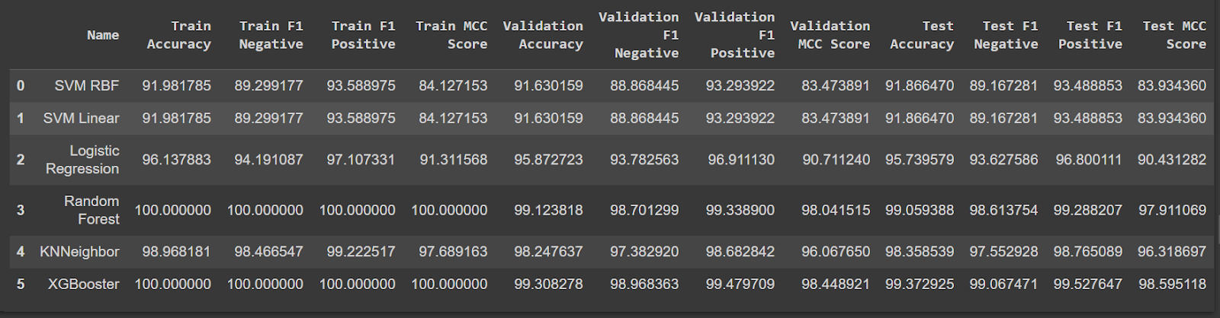
Model Training and Testing for Enzyme & Non-Enzymes
ML algorithms selected: SVM RBF, SVM Linear, Logistic Regression, Random Forest, KNN Neighbor, and XG Booster.
Purpose: Determine the best accuracy by training and testing each model on the dataset.

Slide 23
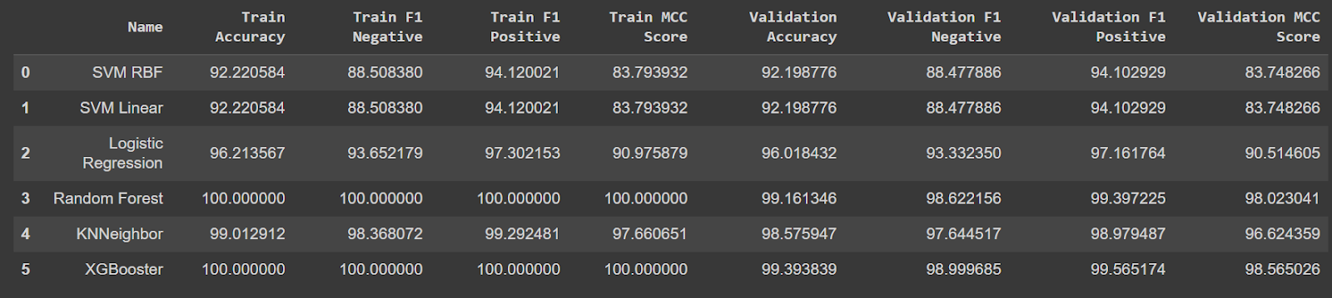
K-fold Cross Validation for Enzyme & Non-Enzyme
Models evaluated: 6 ML models
Evaluation method: k-fold cross-validation (5 folds)
Performance metrics recorded: Training accuracy, F1 score (negative and positive), MCC score, Validation accuracy, F1 score (negative and positive), MCC score.

Slide 24
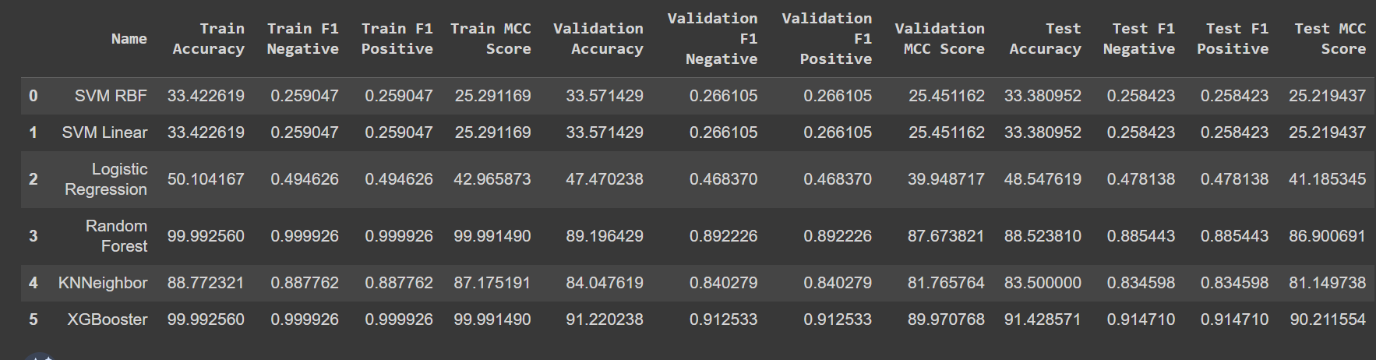
Model training and testing for Main classes and Non-Enzymes
Splitting dataset into train, test and valid
Training [0 1 2 3 4 5 6 7] [1920 1494 1550 1701 1602 1644 1763 1766]
Validation [0 1 2 3 4 5 6 7] [480 373 388 425 400 411 441 442]
Testing [0 1 2 3 4 5 6 7] [600 466 485 531 501 514 551 552]

Slide 25
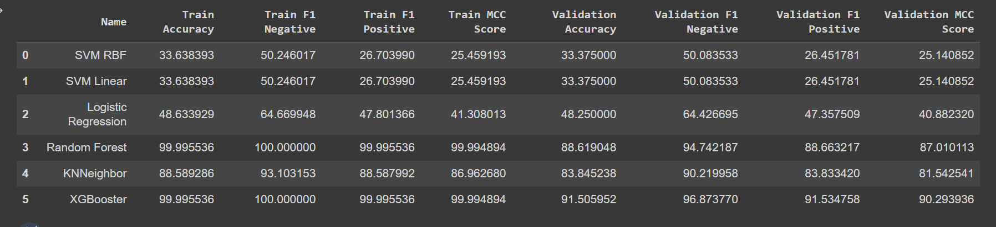
K-fold Cross Validation for Main classes and Non-Enzymes
K-fold Cross Validation with 5 folds

Slide 26
Observations:
Random Forest and XGBoost models show potential overfitting on the training set but perform well on validation and test sets.
Logistic Regression and KNN models demonstrate good performance.
SVM RBF and SVM Linear models show the lowest accuracy and F1 scores.
Random Forest achieves high training accuracy and MCC score but drops in performance on validation and test sets.
XGBoost shows high validation accuracy and F1 score for positive class.
Logistic Regression achieves high F1 score for negative class.
KNNeighbor has high F1 score for positive class in the training set.
XGBoost demonstrates the highest accuracy, F1 scores, and MCC scores on both training and validation sets.
XGBoost shows promise for accurate classification of enzymes and non-enzymes.

Slide 27
Summarization Process
Data Collection
1
Data preprocessing
2
Exploratory Data Analysis
3
Feature Selection
4
Model training
Litareture Review

Slide 28

Conclusion
Class Imbalance: Dataset has class imbalance, with non-enzyme class having larger instances.
Feature Importance: Analyzed feature importance from correlation to identify significant features for enzyme classification.
Data Distribution: Explored feature distribution across different enzyme classes for understanding variations and patterns.
Performance Evaluation: Evaluated models using metrics like accuracy, precision, recall, and F1 score.
Model Interpretability: EDA helped interpret factors influencing model predictions and understand decision rules.
Conclusion: EDA provided insights into class imbalance, feature importance, data distribution, model performance, and interpretability. Guides refinement, addressing class imbalance, and informed decision-making.

Slide 29

Future Work
Sub-Classification of Enzymes: Extend classification to sub-classes within main classes.
Data Collection and Annotation: Gather specialized data for sub-classification.
Preprocessing and Feature Engineering: Develop tailored techniques for sub-class-specific features.
Neural Network Architectures: Explore CNNs, RNNs, and transformer models.
Transfer Learning: Benefit from pre-trained models on protein-related datasets.
Ensemble Approaches: Combine multiple models for improved performance.
Evaluation and Performance Metrics: Define appropriate metrics for sub-classification.
Interpretability and Explainability: Enhance understanding of model decisions.
Model Optimization and Hyperparameter Tuning: Fine-tune model parameters for optimal performance.
Validation and Experimental Validation: Validate results through experimental collaboration.

Slide 30
Reference:
[1] Afshine Amidi, Shervine Amidi et al [3] “ EnzyNet: enzyme classification using 3D convolutional neural networks on spatial representation ” , July 20 2017
[2] H.-B. Shen and K.-C. Chou, ‘‘EzyPred: A top–down approach for predicting enzyme functional classes and subclasses,’’ Biochem. Biophy. Res. Commun., vol. 364, no. 1, pp. 53–59, Dec. 2007
[3] Y. Wang, R. Jing, Y. Hua, Y. Fu, X. Dai, L. Huang, and M. Li, ‘‘Classification of multi-family enzymes by multi-label machine learning and sequence-based descriptors,’’ Anal. Methods, vol. 6, no. 17, pp. 6832–6840, 2014
[4] Z. Zou, S. Tian, X. Gao, and Y. Li, ‘‘MlDEEPre: Multi-functional enzyme function prediction with hierarchical multi-label deep learning,’’ Frontiers Genet., vol. 9, p. 714, Jan. 2019

Slide 31
Thank You!!!

